Slide 1
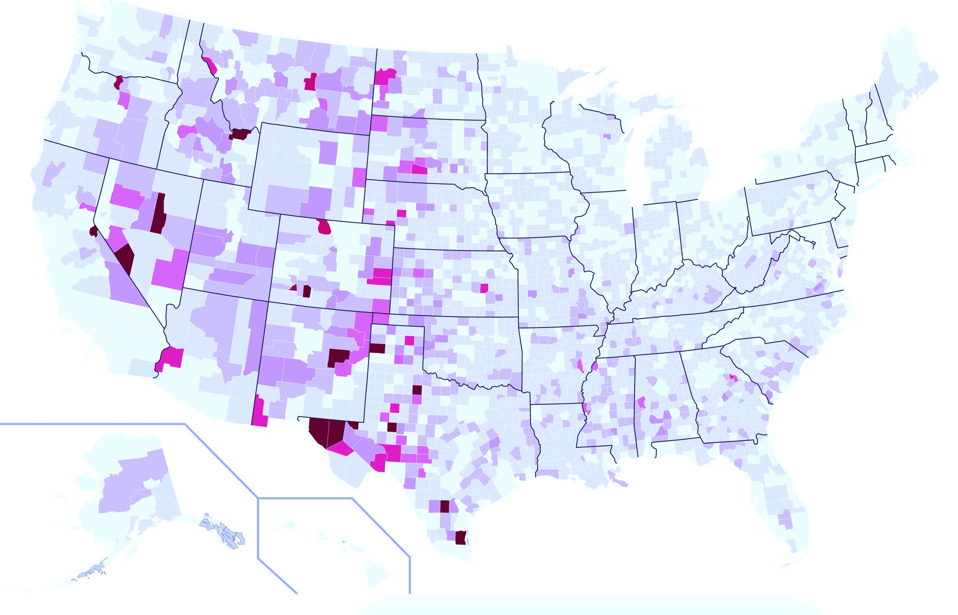

Data Incubator Project Proposal

Slide 2
Motivation
In 2015, about 35k people were killed from motor vehicle crashes in US.
In fact, some counties are more dangerous, and some are safer to drive.
It would be nice to analyze fatality rates at county level.
Future fatality rates can also be predicted at county level.
Insurance companies might find this information useful.

Slide 3
Data sets & Tools
Yearly vehicle crash data at county level from 1975 to 2015
Source: https://www.nhtsa.gov/research-data/fatality-analysis-reporting-system-fars
Size: 400 Mb
Yearly population data at county level from 1969 to 2015
Source: https://seer.cancer.gov/popdata/download.html
Size: 370 Mb
U.S FPIS codes for counties
Source: www.schooldata.com/pdfs/US_FIPS_Codes.xls
Size: 250 Kb
Tools: Pandas, NumPy, Matplotlib

Slide 4
Total Population vs. Total Deaths
How are the population and fatality numbers changing at county level?

Slide 5
Methodology
Purpose: Predict number of deaths per 10,000 people for each county.
Divide the data sets as training and test.
Perform polynomial/linear regression for both population and fatality data for each county in training data sets. More than 6000 distributions for the analysis!
Using the fit parameters, get prediction results and compare it with the test data sets.
First attempt was plotting each data yearly, however statistics is low for number of fatalities in low pop counties.
Second attempt : Rebin the data sets into 5 year intervals and use the average of population and fatality information for each bin.
Calculate (number of deaths/population)*10,000 people for a given time period and compare it with the test data for each county.
2nd order pol.
2nd order pol.
2011-2015 data is for testing
2011-2015 data is for testing

Slide 6
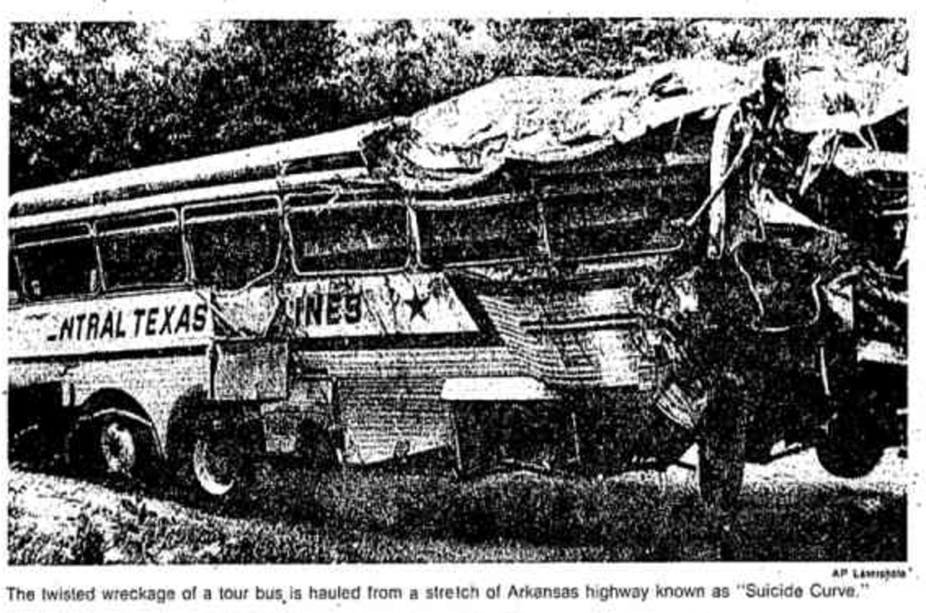
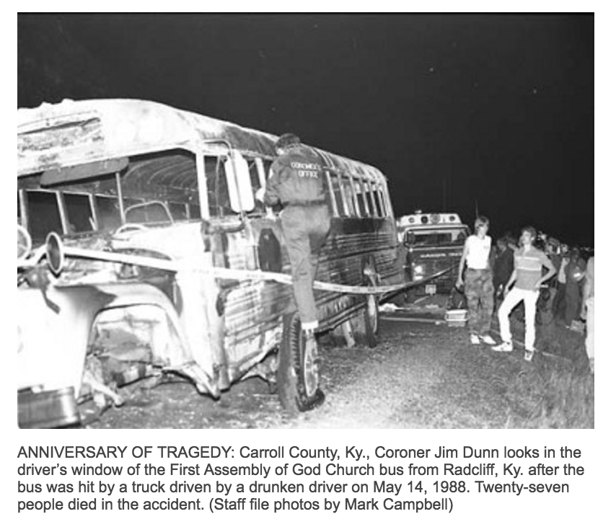
The Good & Bad
5th order pol.
Chicago Tribune, June 6, 1980

Slide 7
Results
Training data: 1976-2010 (7 bins)
Test data: 2011-2015 (1 bin)
Use 4th order pol. for population, 2nd order pol. for fatality data after rebinning.
Pearson correlation coefficient: 0.88 for the whole data.
Some counties have very low population <10k, low statistics.
Check the correlation if county population > 50k, correlation: 0.96.
5th order pol.
2nd order pol.
4th order pol.
Correlation: 0.96!

Slide 8
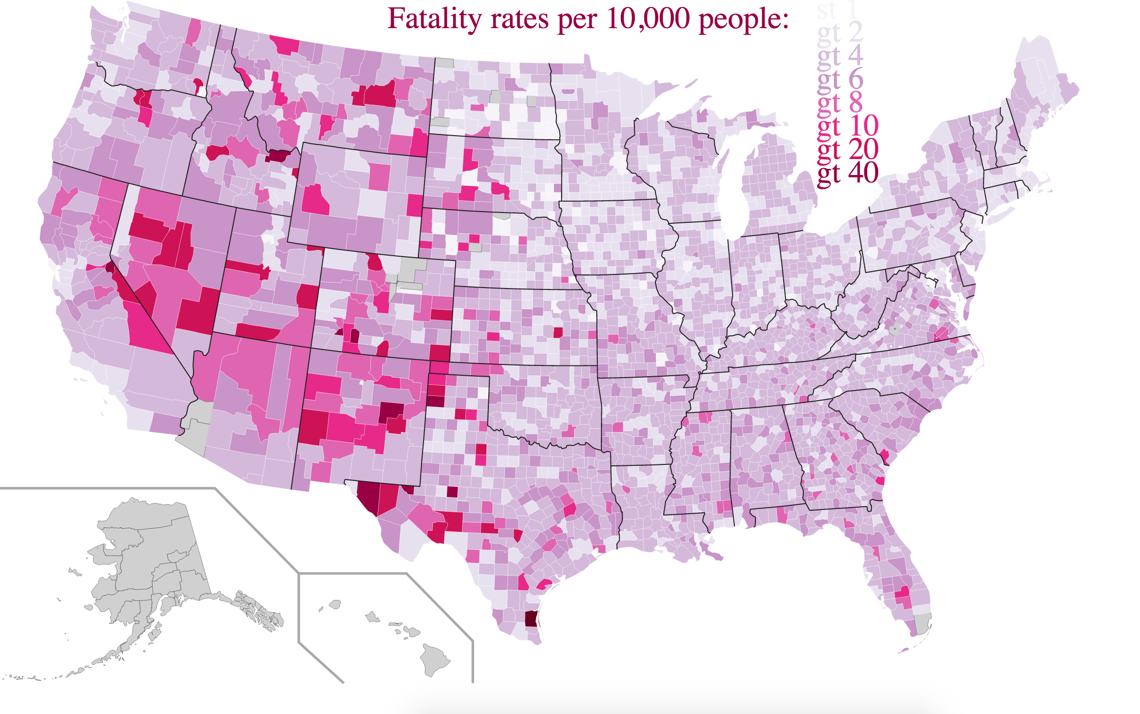
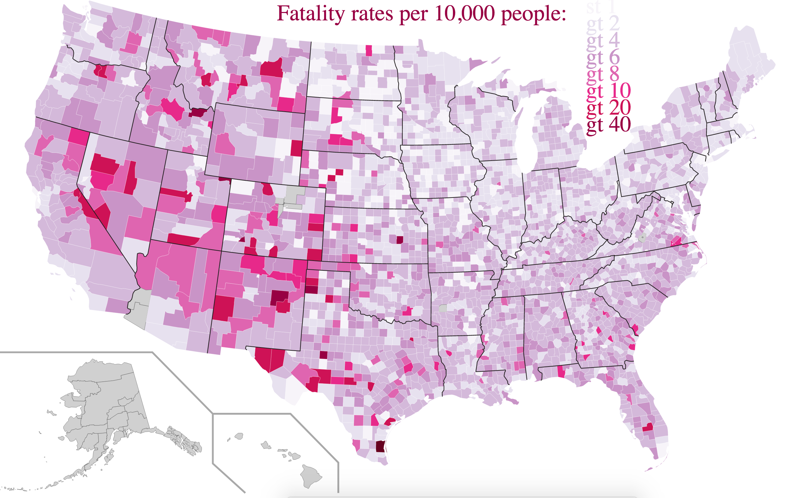
Results
Actual Data
Prediction
Missing data!
Ignore missing data for now.
Kenedy, TX is by far the most dangerous place!
Data is not perfect!
Established in 1980, still missing data!

Slide 9
Outlook
2nd order pol.
Find the missing data from other sources.
Not all regressions are perfect, order of the polynomial in the fit equation for each county can be improved by performing an F-Test.
Correlation number considers, Loving, TX and Los Angeles, CA has the same weight. Data points need to be reweighted.
5th order pol.
5th order pol.

Slide 10
Thank you!

